Slide 1

Introduction to NodeJS

Slide 2
Objective
Have a basic understanding of NodeJS.
Understand event loop & callback concepts in NodeJS.
Know how to create your first application in NodeJS

Slide 3

Agenda
What is NodeJS?
Who uses NodeJS?
Event loop
Event-driven programming

Slide 4
What is NodeJS
Node.js is a server-side platform built on Google Chrome's JavaScript Engine (V8 Engine). Node.js was developed by Ryan Dahl in 2009
Feature of NodeJS
Asynchronous and Event Driven
Single Threaded but Highly Scalable
No Buffering

Slide 5





Who uses Node.js

Slide 6
Who uses Node.js
Following are the areas where Node.js is proving itself as a perfect technology partner.
I/O bound Applications
Data Streaming Applications
Data Intensive Real-time Applications (DIRT)
JSON APIs based Applications
Single Page Applications

Slide 7
Event loop
Node.js is a single-threaded application, but it can support concurrency via the concept of event and callbacks.
Node uses observer pattern
Node thread keeps an event loop and whenever a task gets completed, it fires the corresponding event which signals the event-listener function to execute.

Slide 8
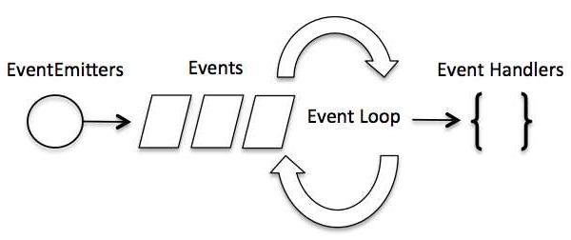
Event-Driven Programming
Notes:
In an event-driven application, there is generally a main loop that listens for events, and then triggers a callback function when one of those events is detected
Although events look quite similar to callbacks, the difference lies in the fact that callback functions are called when an asynchronous function returns its result, whereas event handling works on the observer pattern. The functions that listen to events act as Observers. Whenever an event gets fired, its listener function starts executing. Node.js has multiple in-built events available through events module and EventEmitter class which are used to bind events and event-listeners as follows

Slide 9
Code demo
// Import events module
var events = require('events');
// Create an eventEmitter object
var eventEmitter = new events.EventEmitter();
// Create an event handler as follows
var connectHandler = function connected() {
console.log('connection succesful.');
// Fire the data_received event
eventEmitter.emit('data_received');
}
// Bind the connection event with the handler
eventEmitter.on('connection', connectHandler);
// Bind the data_received event with the anonymous function
eventEmitter.on('data_received', function(){
console.log('data received succesfully.');
});
// Fire the connection event
eventEmitter.emit('connection');
console.log("Program Ended.");

Slide 10
Code demo
Now let's try to run the above program and check its output −
$ node main.js
The following result −
connection successful.
data received successfully.
Program Ended.

Slide 11
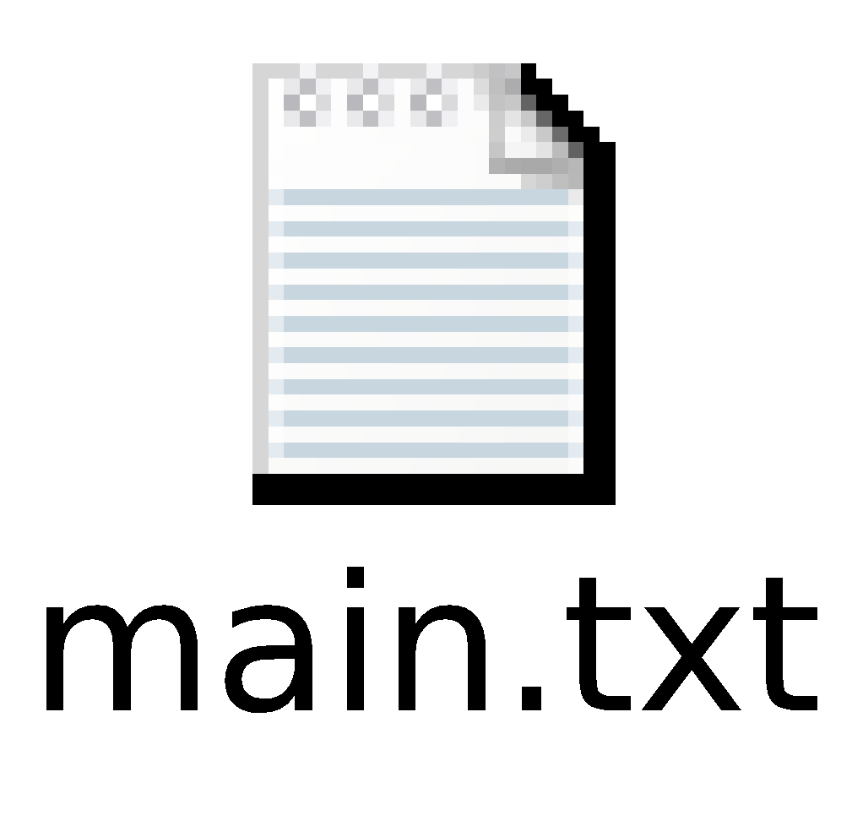
Event Emitter
Create a js file named main.js with the following Node.js code −
Now run the main.js to see the result
− $ node main.js

Slide 12
Callbacks Concept
Callback is an asynchronous equivalent for a function. A callback function is called at the completion of a given task. Node makes heavy use of callbacks. All the APIs of Node are written in such a way that they support callbacks.
Notes:
For example, a function to read a file may start reading file and return the control to the execution environment immediately so that the next instruction can be executed. Once file I/O is complete, it will call the callback function while passing the callback function, the content of the file as a parameter. So there is no blocking or wait for File I/O. This makes Node.js highly scalable, as it can process a high number of requests without waiting for any function to return results.

Slide 13
Blocking Code Example
var fs = require("fs");
var data = fs.readFileSync('input.txt');
console.log(data.toString());
console.log("Program Ended");
Now run the main.js to see the result
− $ node main.js
Notes:
Tutorials Point is giving self learning content
to teach the world in simple and easy way!!!!!
Program Ended
The first example shows that the program blocks until it reads the file and then only it proceeds to end the program.

Slide 14
Non-Blocking Code Example
var fs = require("fs");
fs.readFile('input.txt', function (err, data) {
if (err) return console.error(err); console.log(data.toString());
});
console.log("Program Ended");
Now run the main.js to see the result −
$ node main.js
Notes:
Program Ended
Tutorials Point is giving self learning content to teach the world in simple and easy way!!!!!
The second example shows that the program does not wait for file reading and proceeds to print "Program Ended" and at the same time, the program without blocking continues reading the file.
Thus, a blocking program executes very much in sequence. From the programming point of view, it is easier to implement the logic but non-blocking programs do not execute in sequence. In case a program needs to use any data to be processed, it should be kept within the same block to make it sequential execution.

Slide 15
First Application
Import required modules − We use the require directive to load Node.js modules.
Create server − A server which will listen to client's requests similar to Apache HTTP Server.
Read request and return response − The server created in an earlier step will read the HTTP request made by the client which can be a browser or a console and return the response.

Slide 16
Code sample
var http = require("http");
http.createServer(function (request, response) {
// Send the HTTP header
// HTTP Status: 200 : OK
// Content Type: text/plain
response.writeHead(200, {'Content-Type': 'text/plain'});
// Send the response body as "Hello World"
response.end('Hello World\n');
}).listen(8081);
// Console will print the message
console.log('Server running at http://127.0.0.1:8081/');

Slide 17
Thank you

